Slide 1

OTC: QBAK
Celebrating more than
4 Decades
Data Storage Expertise

Slide 2
FORWARD LOOKING STATEMENT
This investment summary contains forward-looking statements within the meaning of the safe harbor provisions of the Private Securities Litigation Reform Act of 1995. Forward-looking statements include, but are not limited to, Qualstar’s views on future financial and operating performance and growth in the markets served by Qualstar’s products, and future product initiatives, and are generally identified by phrases such as “thinks,” “anticipates,” “believes,” “estimates,” “expects,” “intends,” “plans,” and similar words. Forward-looking statements are not guarantees of future performance and are inherently subject to uncertainties and other factors which could cause actual results to differ materially from the forward-looking statement. These statements are based upon, among other things, assumptions made by, and information currently available to, management, including management’s own knowledge and assessment of Qualstar’s industry, R&D initiatives, competition and capital requirements. Other factors and uncertainties that could affect the Qualstar’s forward-looking statements include, among other things, the following: our ability to develop and commercialize new products; industry and customer adoption and acceptance of our new products; our ability to increase sales of our products; the rescheduling or cancellation of customer orders; unexpected shortages of critical components; unexpected product design or quality problems; adverse changes in market demand for our products; increased competition and pricing pressure on our products; a decrease in the quality and/or reliability of our products; protection of our proprietary intellectual property; competition by alternative sophisticated as well as generic products; continued availability of raw materials for our products at competitive prices; disruptions in our manufacturing facilities; risks of international sales and operations including fluctuations in exchange rates; compliance with regulatory requirements applicable to our manufacturing operations; and customer concentrations. Qualstar undertakes no obligation to publicly update or revise any forward-looking statements, whether as a result of new information, future events or otherwise.

Slide 3
QUALSTAR: AN UNDISCOVERED LEADER POSITIONED FOR SCALE
Financially strong and uplisting-ready.
Leadership has proven M&A execution.
Positioned in massive market tailwinds.
Clear path to scale via broader product offerings, partnerships, software, and acquisitions.

Slide 4
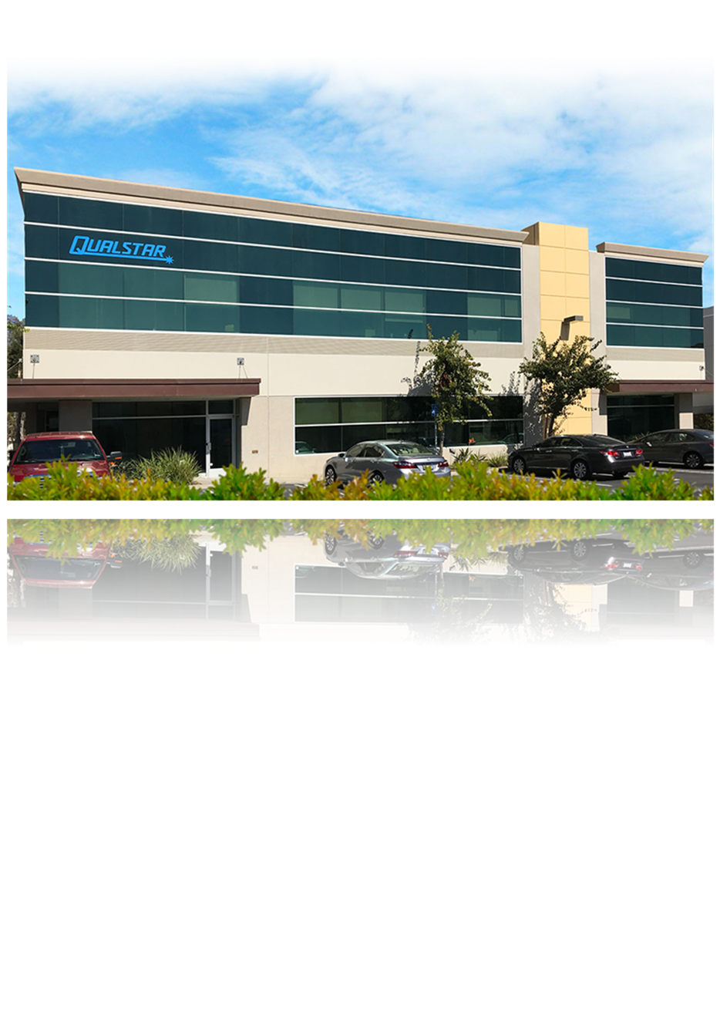

ABOUT QUALSTARTRUSTED DATA STORAGE PIONEER
About Us
Founded in California in 1984, Southern California HQ.
Thousands of tape libraries shipped worldwide.
Wholly own subsidiary N2Power, designing high efficiency power supplies.
Trusted across media, defense, oil & gas, healthcare, education, and cloud.

Slide 5


LEADERSHIP TEAM
Steven N. Bronson
Chief Executive Officer
Steve Bronson has over 40 years of business and entrepreneurial expertise, with a strong background in investment banking, operations and management. Since July 2013, Steve has served as President and CEO of Qualstar Corporation, a leading manufacturer of high-quality tape library systems and its subsidiary, N2Power, known for high efficiency power supplies for diverse electronic industries.
Jeff Sengpiehl
Chief Technology Officer
Jeff serves as a thought leader in the media and entertainment industry with over 30 years of experience uniting creativity and technology to drive operational change. He has worked for key industry players in planning, developing, and building the next generation of video production and post-production workflows. Jeff joined the Qualstar team as UTO, leveraging his background and expertise to meet the technical demands for data retention

Slide 6
EXPLODING DATA GROWTH: TAPE IS THE SWEET SPOT
Global Data Storage Market
Growing from $255B in 2025 to $774B in 2032 (CAGR: 17.2%)
Driven by archiving, preservation, accessibility, and security needs
Qualstar (OTC: QBAK) is positioned as a global leader in storage hardware & software
Why Tape Storage Wins
Reliable & secure — protects data for up to 30 years
Air-gapped to safeguard against ransomware and cyberattacks
Accessible & scalable for long-term storage needs
Lowest TCO compared to hard drives, optical, or other alternatives
80% of the worlds data is cold storage-the tape use case
The Data Storage Market is expected to grow at 17.2% CAGR (2025-2032)
$774.00
Billion
$244.29
Billion
$218.33
Billion
2024
2025
2032
Fortune Business Insights, Data Storage Market (2025) https://www.fortunebusinessinsights.com/data-storage-market-102991
Fortune Business Insights, Data Storage Market (2025) https://www.fortunebusinessinsights.com/data-storage-market-102991

Slide 7
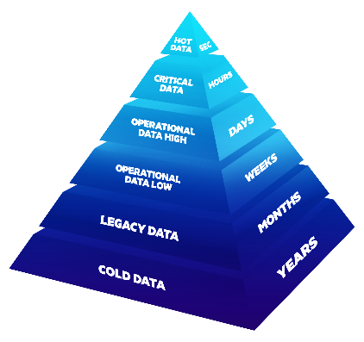
TAPE’S ROLE IN THE DATA ECOSYSTEM
Tape is the backbone of the world’s long-term data preservation strategy.
Each cartridge can store terabytes of data
Tape maintains data integrity for up to 30 years
Lower power consumption makes it a green alternative to hard drives
Barcode tracking system keeps data organized
Since tapes can be removed from the library, the data on the tapes are more secure from cyberattacks and ransomware
Compared to hard drives, optical data storage devices, and other storage alternatives, tape is still the most cost-effective solution for data storage

Slide 8
TAPE MISCONCEPTION VS. REALITY
Myths
Reality
Obsolete
Unsecure
Expensive
Indispensable
Ransomware protection
Lowest TCO
ESG-Friendly

Slide 9
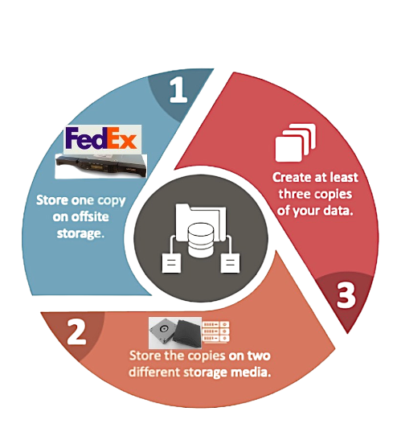
3:2:1 OF DATA STORAGE
Think of it like financial diversification:
You wouldn't put all cash in a single bank or a single stock.
You spread it across accounts, asset types, and geographies to minimize risk.
3:2:1 applies the same principle to data as a financial asset.
3: 2: 1
3 copies of data Always keep at least three separate copies of important information
2 different storage type Store the copies on at least two different types of media (e.g., local servers + cloud, or disk + tape)
1 off-site copy Keep at least one copy offsite (physically or in the cloud) so that a local disaster (fire, flood, ransomware) won’t wipe everything out

Slide 10
THE QUALSTAR ADVANTAGE
Lowest total cost of ownership
Ransomware protection (air gap)
40+ years data integration
Fast fulfillment, no slot fees, US based support

Slide 11

Industries
TRUSTED ACROSS MISSION-CRITICAL MARKETS
Media & Entertainment
Banking
Government & Military
Oil & Gas
Data Centers
Medical Imaging

Slide 12
GROWTH STRATEGY
Strategic Partnerships
e.g. CMS
Software expansion for recurring revenues
M&A
Monetize installed base

Slide 13
DEBT-FREE, CASH POSITIVE, POSITIONED FOR GROWTH
 | Three Month Ended Sept. 30 |  |  | Nine Month Ended Sept. 30 |  |  | Year End
*in thousands | 2025 | 2024 |  | 2025 | 2024 |  | 2024
Revenues | $2,018 | $1,358 |  | $5,107 | $6,011 |  | $8,044
Gross Profit | $692 | $552 |  | $1,783 | $1,775 |  | $2,458
Gross Margin | 34.3% | 40.6% |  | 34.9% | 29.5% |  | 30.1%
Income (loss) from operations | $39 | $(44) |  | $179 | $(532) |  | $(470)
Net Income (loss) | $219 | $(34) |  | $606 | $(461) |  | $(471)
Earnings (loss) per share | $0.15 | $(0.02) |  | $0.43 | $(0.32) |  | $(0.33)
FINANCIAL SNAPSHOT
$2.3M in cash & cash equivalent Debt free Cash flow positive
Financial data above includes N2Power

Slide 14
QUALSTAR: ESSENTIAL TECHNOLOGY POSTIONED FOR SCALE
Tape is indispensable infrastructure for the world’s cold data storage needs.
Strong financial foundation-debt free, cash positive, profitable.
M&A is our proven growth engine.
Uplisting is a vehicle to accelerate scale, enabling institutional visibility, liquidity, and strategic partnerships.
Positioned in a high growth market due to the explosive demand for data retention.

Slide 15
CONTACT INFORMATION
Qualstar Corporation
1267 Flynn Rd, Camarillo, CA 93012
Main Telephone (805) 583-7744
Toll Free (877) 886-2758
Main Fax (805) 978-5984
INVESTOR RELATIONS: QBAK@qualstar.com

Slide 16
Appendix

Slide 17
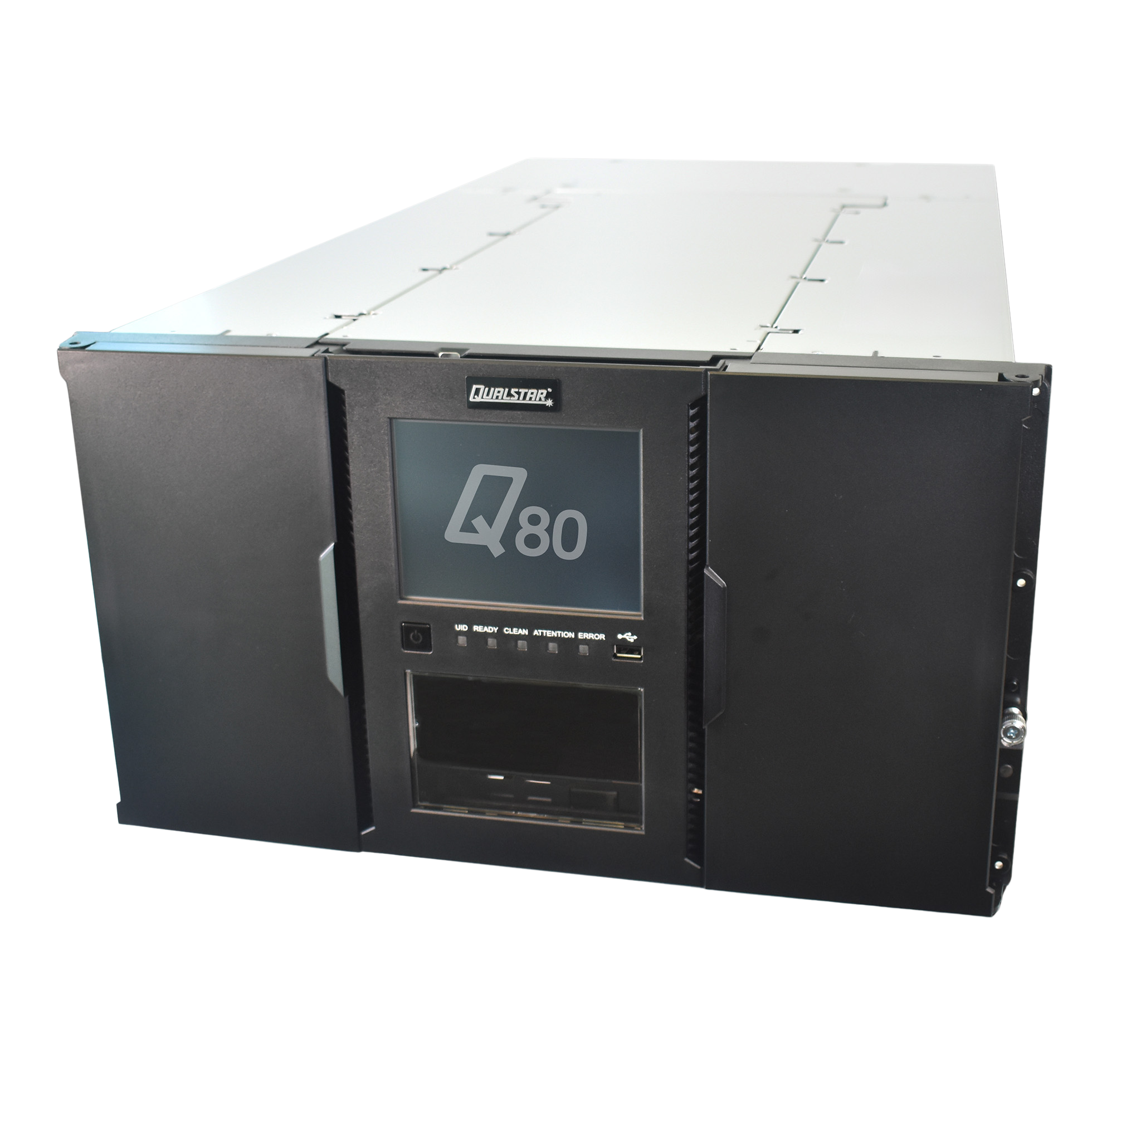
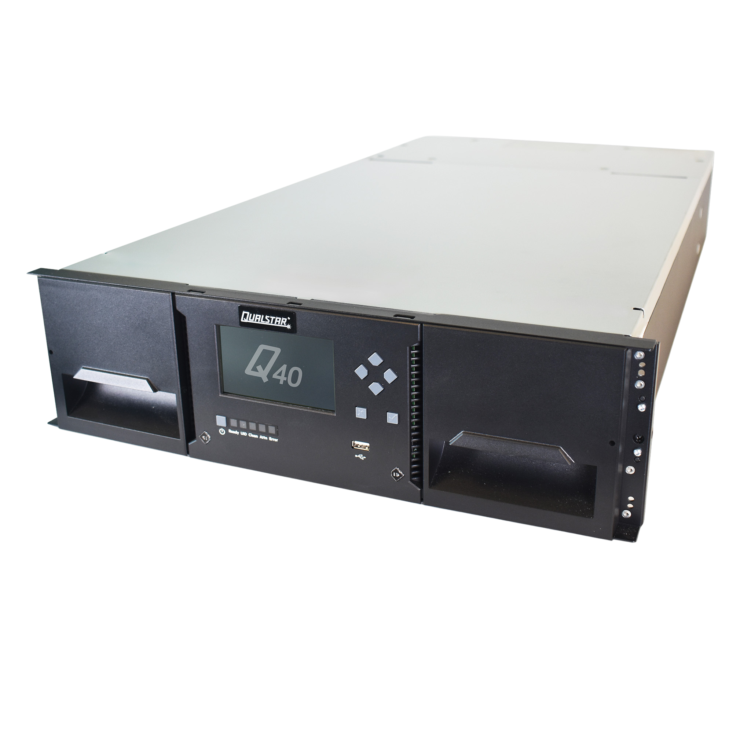
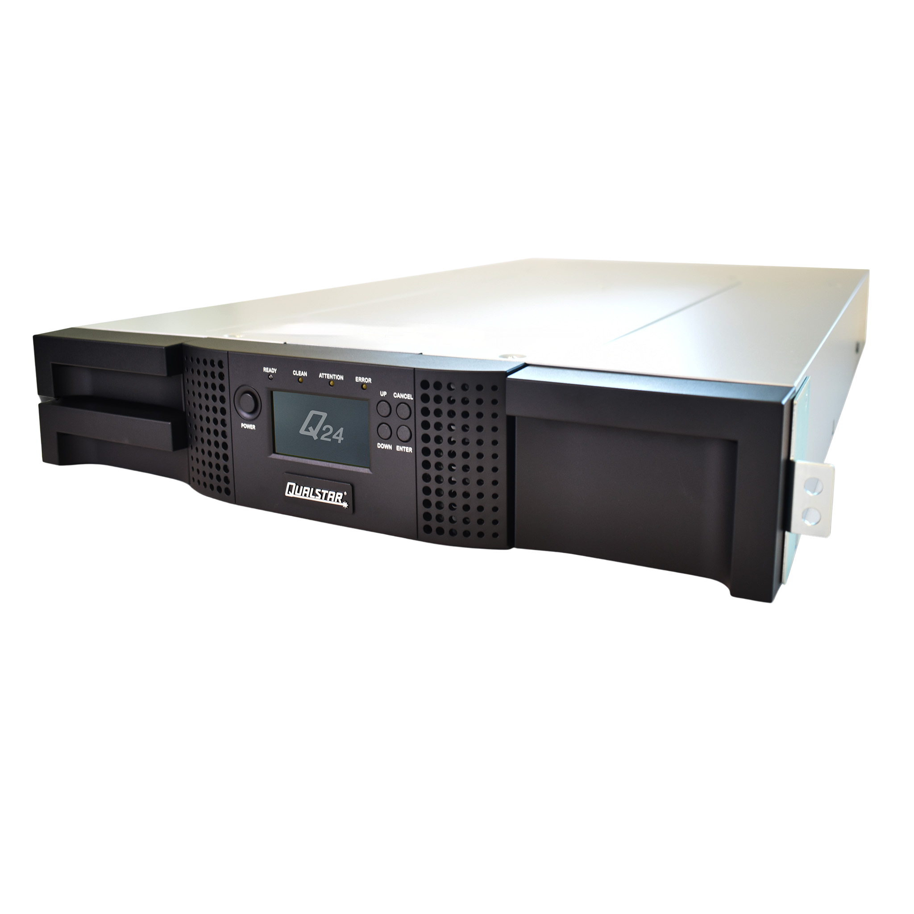
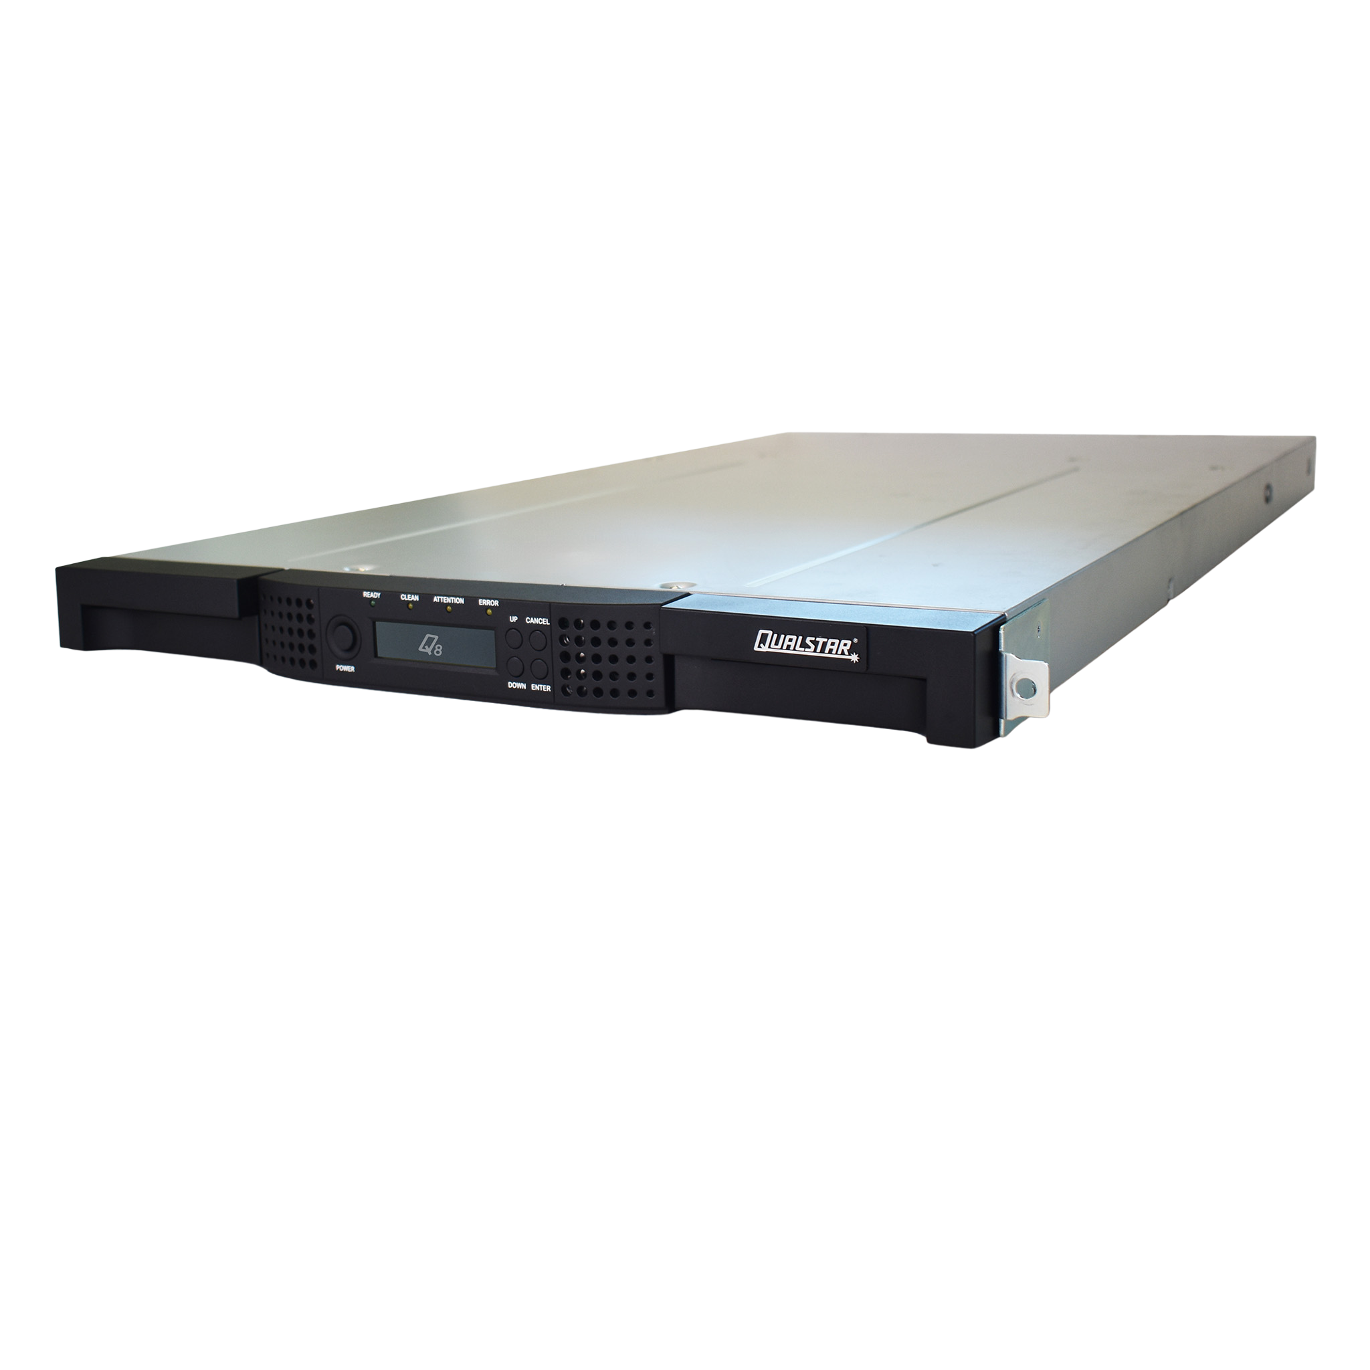
QUALSTAR Q-SERIES TAPE LIBRARIES
Rack mount or stand-alone Tape Libraries
From small business to enterprise class
18 TB – 10.08 PB native capacity
Encryption capable
Engineered for reliability
Browser-based remote management
capability simplifies IT administration
CE, FCC, and UL certified​
Four models to chose from
Two- or three-year warranty
Expandable
Q80
Expandable up t0 560 slots
Up to 10.08 PB of data capacity
Q40
Expandable up t0 640 slots
Up to 11.52 PB of data capacity
Q24
Up t0 24 slots
Up to 1080 TB of data capacity
Q8
Up t0 8 slots
Up to 360 TB of data capacity

Slide 18
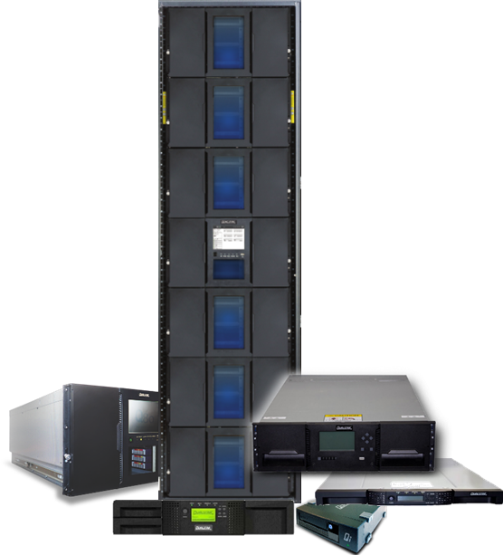
OUR TAPE LIBRARIES DELIVER
Data Security
WORM technology for data immutability
Air gap makes data harder to hack
Real Value
1/5th the acquisition cost of disk
1/20th the operating cost of disk
30+ years media life, three
times longer than disc

Slide 19
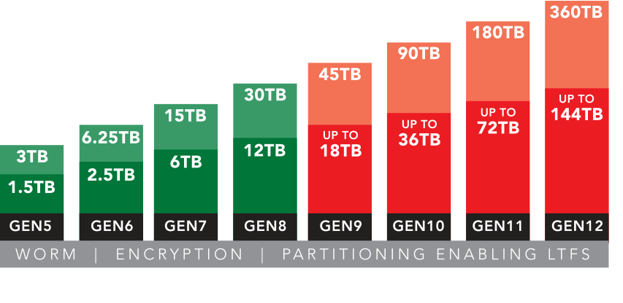
LINEAR TAPE: OPEN (LTO) ULTRIUM ROADMAP
© 2023 | All Rights Reserved | Confidential

